Slide 1
1.3 Text, sound and images
Calculating the size of an image and sound file

Slide 2


Calculating file sizes
Image files
Sound files

Slide 3
Calculating file sizes
Image files
Sound files
Sample rate
×
Duration (s)
×
Resolution

Slide 4
Calculating file sizes
Image files
Sound files
Sample rate
×
Duration (s)
×
Resolution
Colour depth
×
Image height (px)
×
Image width (px)

Slide 5
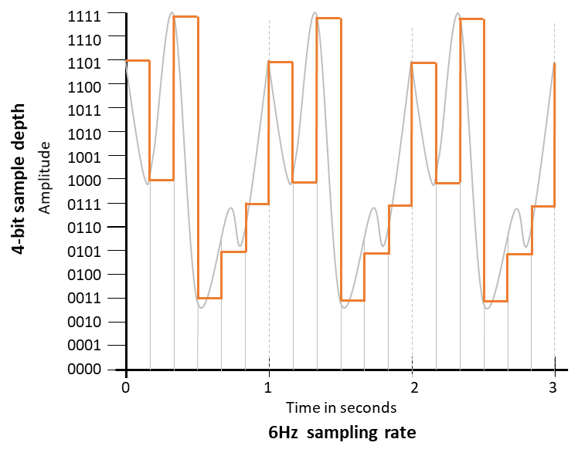
Calculating sound file sizes
Sample rate
×
Duration (s)
×
Resolution
Sound file size
Sample rate |  | Number of samples per second
Duration |  | Length of sample in seconds
Resolution |  | Number of bits required to store each sample

Slide 6
Calculating sound file sizes
Sample rate
×
Duration (s)
×
Resolution
Sound file size
Sample rate | 6 | Number of samples per second
Duration |  | Length of sample in seconds
Resolution |  | Number of bits required to store each sample

Slide 7
Calculating sound file sizes
Sample rate
×
Duration (s)
×
Resolution
Sound file size
Sample rate | 6 | Number of samples per second
Duration | 3 | Length of sample in seconds
Resolution |  | Number of bits required to store each sample

Slide 8
Calculating sound file sizes
Sample rate
×
Duration (s)
×
Resolution
Sound file size
Sample rate | 6 | Number of samples per second
Duration | 3 | Length of sample in seconds
Resolution | 4 | Number of bits required to store each sample

Slide 9

Calculating sound file sizes
Sample rate
×
Duration (s)
×
Resolution
Sound file size
Sample rate | 6 | Number of samples per second
Duration | 3 | Length of sample in seconds
Resolution | 4 | Number of bits required to store each sample
6 × 3 × 4 | = | 72 bits = 9 bytes
We cover the topic of sound in more detail in our video titled
CAMBRIDGE IGCSE (0487-0984) 1.2 Representing sound

Slide 10
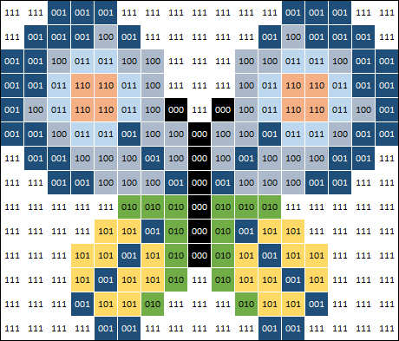
Calculating image file sizes
Colour depth
×
Image height (px)
×
Image width (px)
Image file size
Image height |  | Height measured in pixels
Image width |  | Width measured in pixels
Colour depth |  | Number of bits required to store each pixel

Slide 11
Calculating image file sizes
Colour depth
×
Image height (px)
×
Image width (px)
Image file size
Image height | 14 | Height measured in pixels
Image width |  | Width measured in pixels
Colour depth |  | Number of bits required to store each pixel

Slide 12
Calculating image file sizes
Colour depth
×
Image height (px)
×
Image width (px)
Image file size
Image height | 14 | Height measured in pixels
Image width | 17 | Width measured in pixels
Colour depth |  | Number of bits required to store each pixel

Slide 13
Calculating image file sizes
Colour depth
×
Image height (px)
×
Image width (px)
Image file size
Image height | 14 | Height measured in pixels
Image width | 17 | Width measured in pixels
Colour depth | 3 | Number of bits required to store each pixel

Slide 14
Calculating image file sizes
Colour depth
×
Image height (px)
×
Image width (px)
Image file size
Image height | 14 | Height measured in pixels
Image width | 17 | Width measured in pixels
Colour depth | 3 | Number of bits required to store each pixel
14 × 17 × 3 | = | 714 bits = 90 bytes
We cover the topic of images in more detail in our video titled
CAMBRIDGE IGCSE (0487-0984) 1.2 Representing images

Slide 15

Calculating the size of an image and sound file
Calculating image file sizes: (Colour depth) × (Image height px) × (Image width px)
Calculating sound file sizes: (Sample rate) × (Duration in seconds) × (Resolution)

Slide 16


